Slide 1
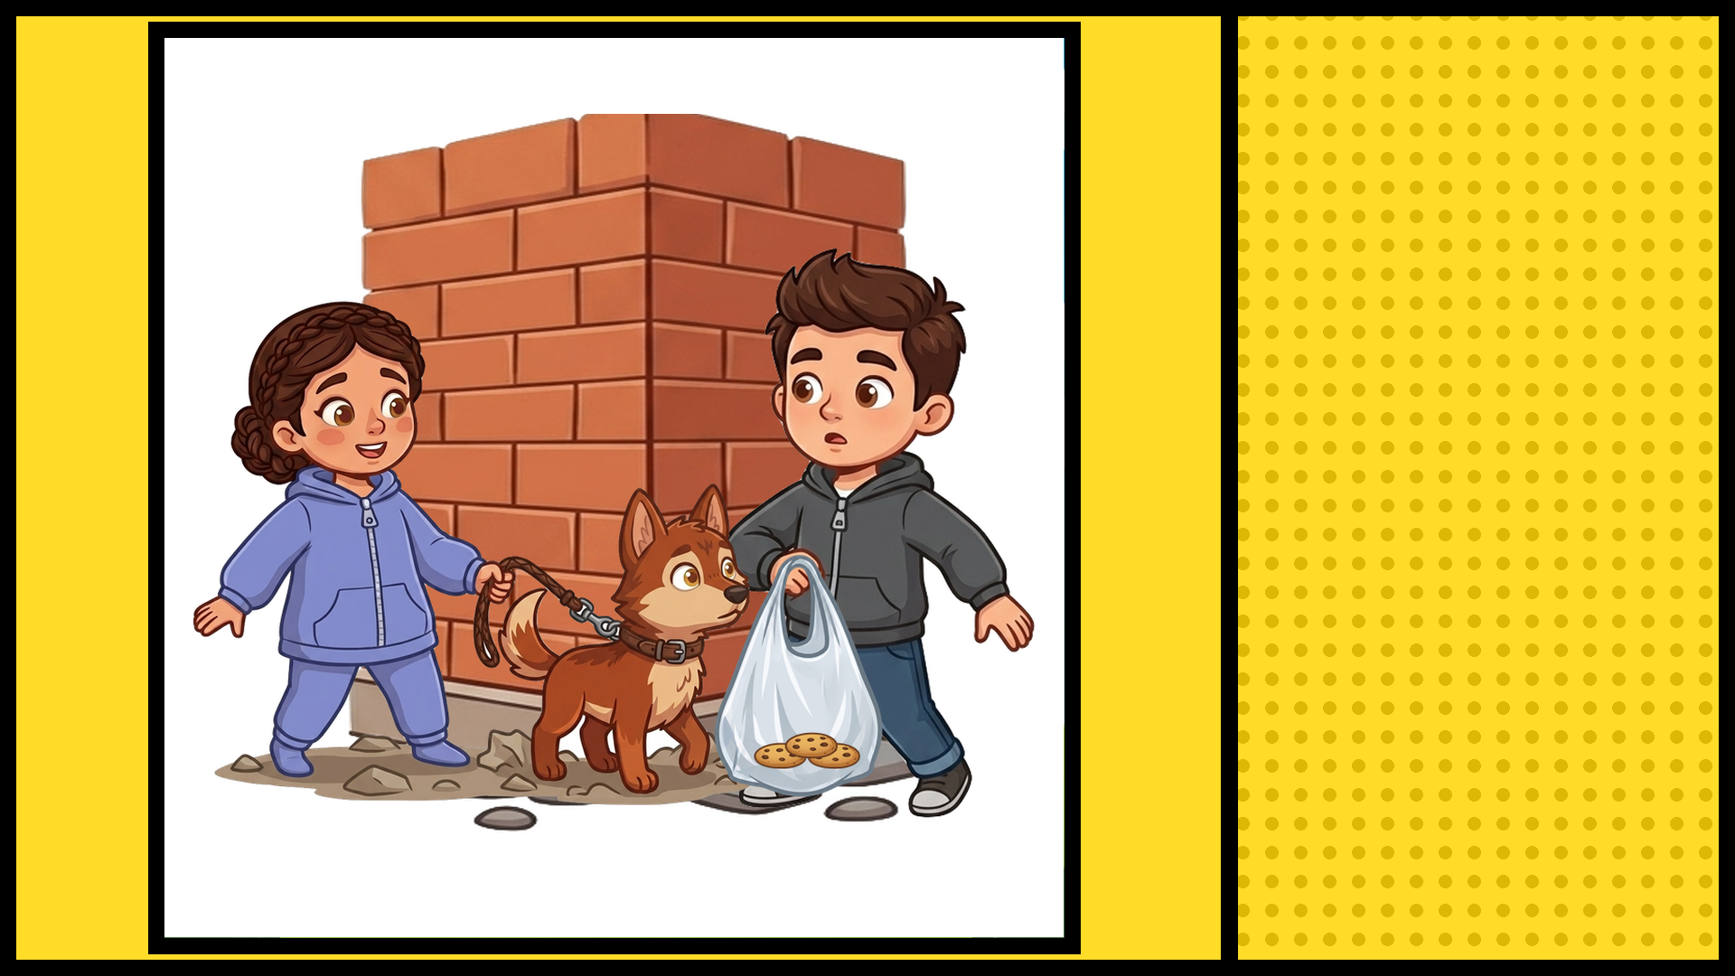
ANDY AND CATHERINE
EACH HAD A BAG
OF COOKIES

Slide 2
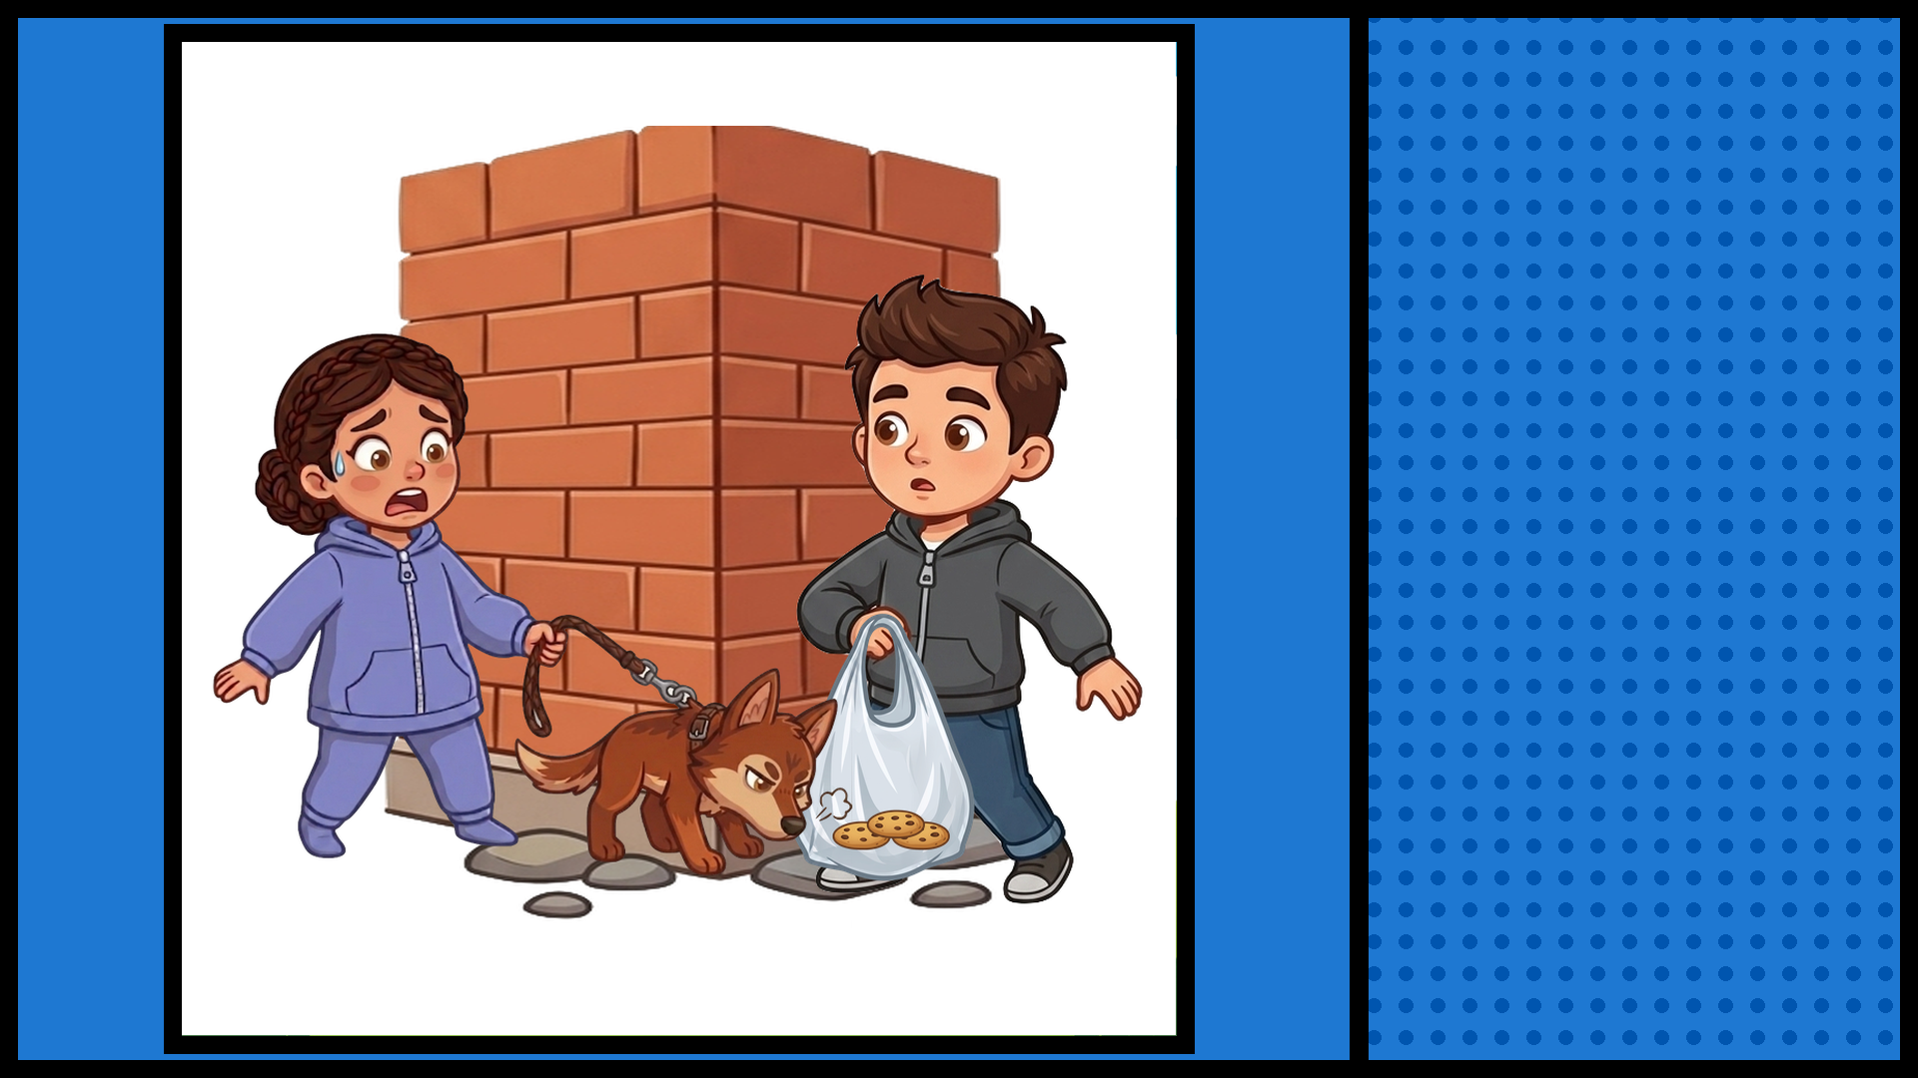
CATHERINE'S WOLF
SNIFFED ANDY'S
COOKIES!

Slide 3
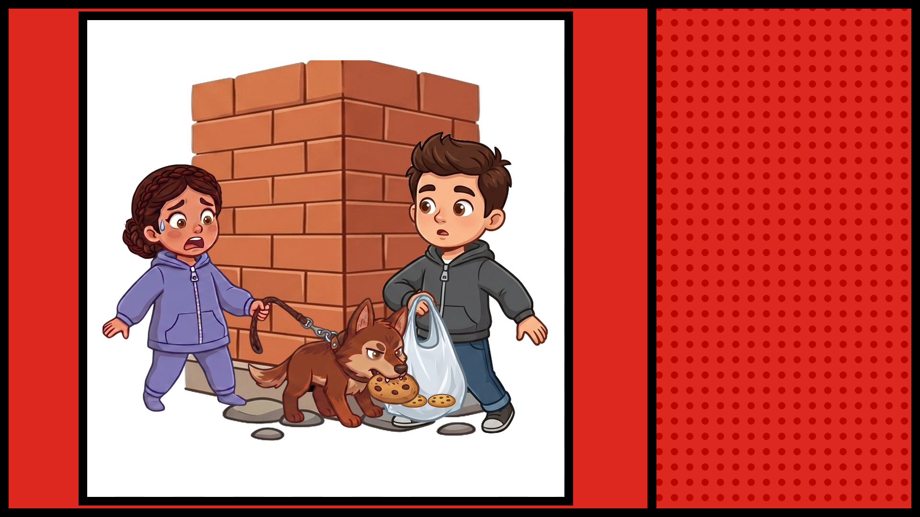
CATHERINE'S WOLF
ATE 1 OF ANDY'S
COOKIES!

